Slide 1
Introduction and Overview
1

Slide 2
What is an OS
An OS is a program that acts an intermediary between the user of a computer and computer hardware.
Operating system goals:
Execute user programs and make solving user problems easier
Make the computer system convenient to use
Use the computer hardware in an efficient manner
Major cost of general purpose computing is software.
OS simplifies and manages the complexity of running application programs efficiently.

Slide 3
Computer System Structure
Computer system can be divided into four components
Hardware – provides basic computing resources
CPU, memory, I/O devices
Operating system
Controls and coordinates use of hardware among various applications and users
Application programs – define the ways in which the system resources are used to solve the computing problems of the users
Word processors, compilers, web browsers, database systems, video games
Users
People, machines, other computers

Slide 4
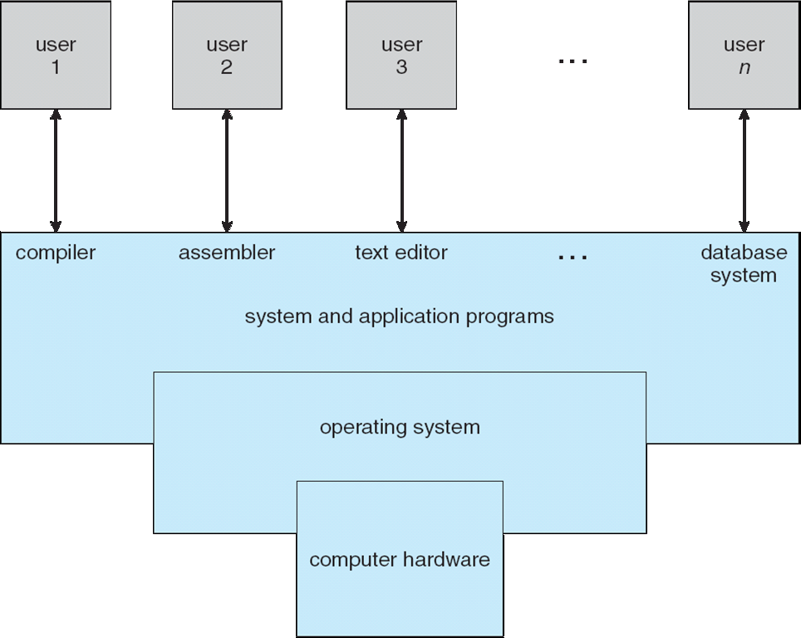
Computer System Structure

Slide 5
Operating System Definition
OS is a resource allocator
Manages all resources
Decides between conflicting requests for efficient and fair resource use
OS is a control program
Controls execution of programs to prevent errors and improper use of the computer
No universally accepted definition
“Everything a vendor ships when you order an operating system” is good approximation
But varies wildly
“The one program running at all times on the computer” is the kernel. Everything else is either a system program (ships with the operating system) or an application program

Slide 6
Operating System Spectrum
Monitors and Small Kernels
special purpose and embedded systems, real-time systems
Batch and multiprogramming
Timesharing
workstations, servers, minicomputers, timeframes
Transaction systems
Personal Computing Systems
Mobile Platforms, devices (of all sizes)
6

Slide 7
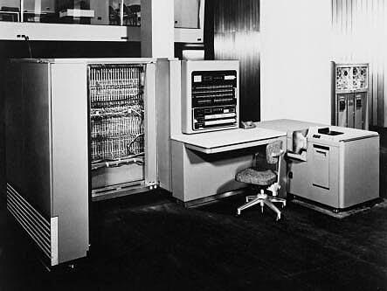
Early Systems - Bare Machine (1950s)
Structure
Large machines run from console
Single user system
Programmer/User as operator
Paper tape or punched cards
Early software
Assemblers, compilers, linkers, loaders, device drivers, libraries of common subroutines.
Secure execution
Inefficient use of expensive resources
Low CPU utilization, high setup time.
Hardware – expensive ; Human – cheap
From John Ousterhout slides
7

Slide 8
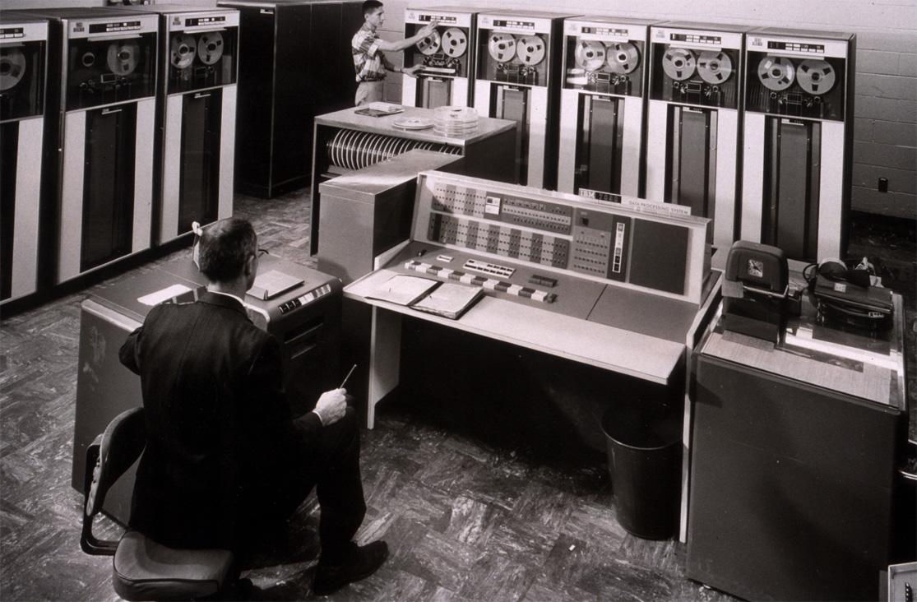
Simple Batch Systems (1960’s)
Reduce setup time by batching jobs with similar requirements.
Add a card reader, Hire an operator
User is NOT the operator
Automatic job sequencing
Forms a rudimentary OS.
Resident Monitor
Holds initial control, control transfers to job and then back to monitor.
Problem
Need to distinguish job from job and data from program.
From John Ousterhout slides
8

Slide 9
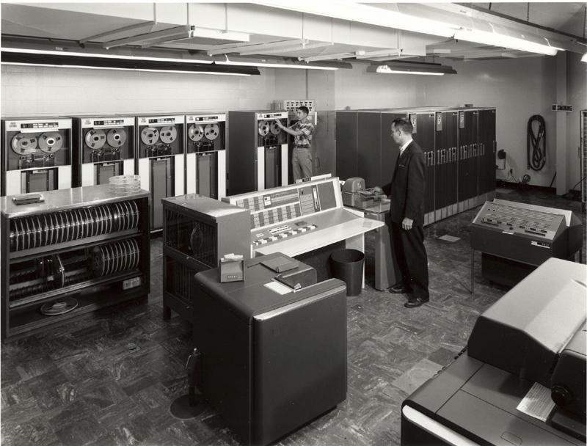
Supervisor/Operator Control
Secure monitor that controls job processing
Special cards indicate what to do.
User program prevented from performing I/O
Separate user from computer
User submits card deck
cards put on tape
tape processed by operator
output written to tape
tape printed on printer
Problems
Long turnaround time - up to 2 DAYS!!!
Low CPU utilization
I/O and CPU could not overlap; slow mechanical devices.
IBM 7094
From John Ousterhout slides
9

Slide 10
Batch Systems - Issues
Solutions to speed up I/O:
Offline Processing
load jobs into memory from tapes, card reading and line printing are done offline.
Spooling
Use disk (random access device) as large storage for reading as many input files as possible and storing output files until output devices are ready to accept them.
Allows overlap - I/O of one job with computation of another.
Introduces notion of a job pool that allows OS choose next job to run so as to increase CPU utilization.
10

Slide 11
Multiprogramming
Use interrupts to run multiple programs simultaneously
When a program performs I/O, execute another program till interrupt is received.
Requires secure memory, I/O for each program.
Requires intervention if program loops indefinitely.
Requires CPU scheduling to choose the next job to run.
11

Slide 12
Timesharing
Programs queued for execution in FIFO order.
Like multiprogramming, but timer device interrupts after a quantum (timeslice).
Interrupted program is returned to end of FIFO
Next program is taken from head of FIFO
Control card interpreter replaced by command language interpreter.
Hardware – getting cheaper; Human – getting expensive
12

Slide 13
Timesharing (cont.)
Interactive (action/response)
when OS finishes execution of one command, it seeks the next control statement from user.
File systems
online filesystem is required for users to access data and code.
Virtual memory
Job is swapped in and out of memory to disk.
13

Slide 14
Personal Computing Systems
Single user systems, portable.
I/O devices - keyboards, mice, display screens, small printers.
Laptops and palmtops, Smart cards, Wireless devices.
Single user systems may not need advanced CPU utilization or protection features.
Advantages:
user convenience, responsiveness, ubiquitous
Hardware – cheap ; Human – expensive
14

Slide 15
Parallel Systems
Multiprocessor systems with more than one CPU in close communication.
Improved Throughput, economical, increased reliability.
Kinds:
Vector and Multicore
Symmetric and asymmetric multiprocessing
Distributed memory vs. shared memory
Programming models:
Tightly coupled vs. loosely coupled ,message-based vs. shared variable
15

Slide 16
Distributed Systems
Distribute computation among many processors.
Loosely coupled -
no shared memory, various communication lines
client/server architectures
Advantages:
resource sharing
computation speed-up
reliability
communication - e.g. email
Applications - digital libraries, digital multimedia
Hardware – very cheap ; Human – very expensive
16

Slide 17
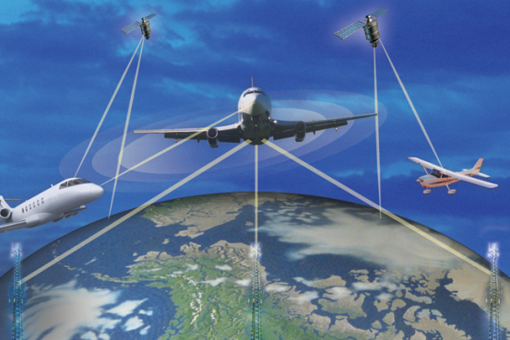

Real-time systems
Correct system function depends on timeliness
Feedback/control loops
Sensors and actuators
Hard real-time systems -
Failure if response time too long.
Secondary storage is limited
Example: Air traffic control, Medical
Soft real-time systems -
Less accurate if response time is too long.
Useful in applications such as multimedia, virtual reality.
Principles of Operating Systems - Lecture 1
17

Slide 18
Operating Systems: How are they organized?
Simple
Only one or two levels of code
Layered
Lower levels independent of upper levels
Modular
Core kernel with Dynamically loadable modules
Microkernel
OS built from many user-level processes
18

Slide 19
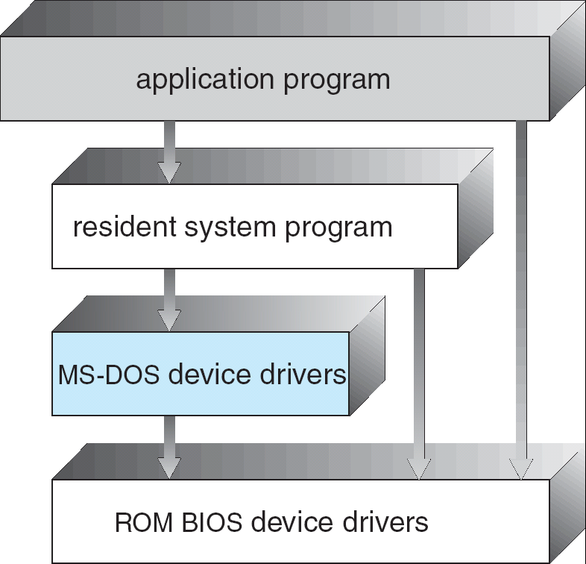
OS Structure - Simple Approach
MS-DOS - provides a lot of functionality in little space.
Not divided into modules, Interfaces and levels of functionality are not well separated
19

Slide 20
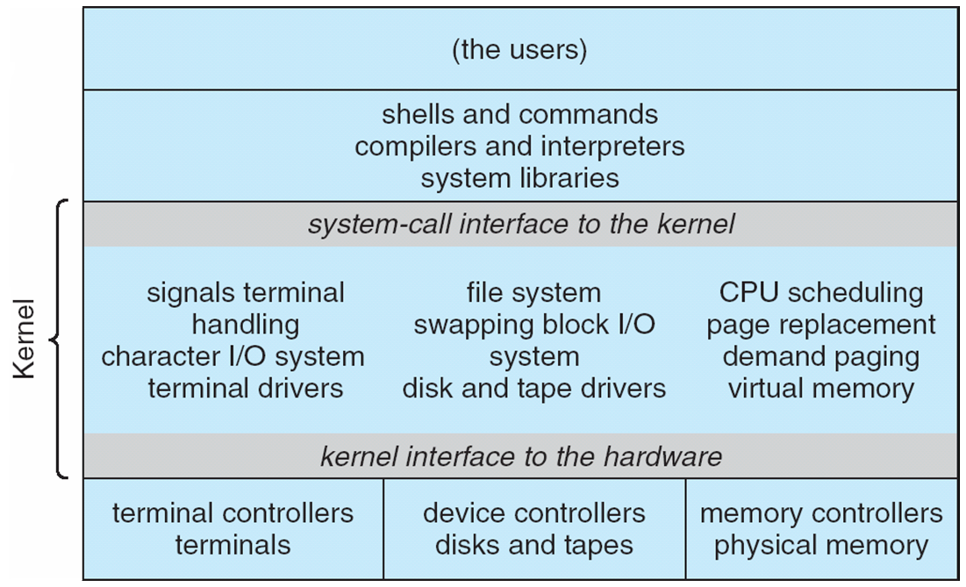
Original UNIX System Structure
Limited structuring, has 2 separable parts
Systems programs
Kernel
everything below system call interface and above physical hardware.
Filesystem, CPU scheduling, memory management
20
Notes:
AIT NIST 041207
DRAFT of 04/03/07
20
DARPA12

Slide 21
Original UNIX System Structure
Limited structuring, has 2 separable parts
Systems programs
Kernel
everything below system call interface and above physical hardware.
Filesystem, CPU scheduling, memory management
21
Notes:
AIT NIST 041207
DRAFT of 04/03/07
21
DARPA12

Slide 22
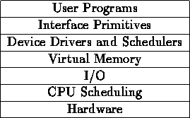
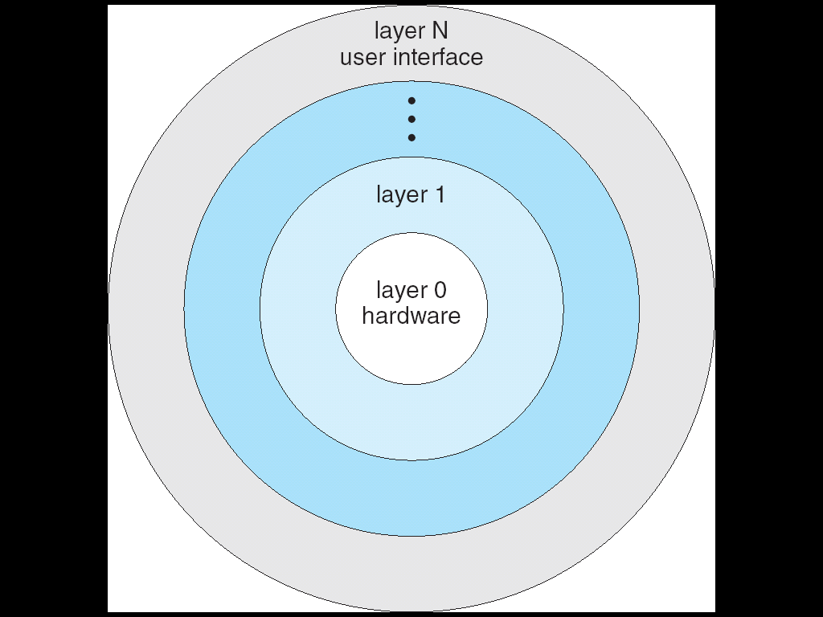
Layered OS Structure
OS divided into number of layers - bottom layer is hardware, highest layer is the user interface.
Each layer uses functions and services of only lower-level layers.
THE Operating System and Linux Kernel has successive layers of abstraction.
22

Slide 23
Monolithic vs. Microkernel OS
Monolithic OSes have large kernels with a lot of components
Linux, Windows, Mac
Microkernels moves as much from the kernel into “user” space
Small core OS components running at kernel level
OS Services built from many independent user-level processes
Communication between modules with message passing
Benefits:
Easier to extend a microkernel
Easier to port OS to new architectures
More reliable and more secure (less code is running in kernel mode)
Fault Isolation (parts of kernel protected from other par
Detriments:
Performance overhead severe for naïve implementation
23

Slide 24
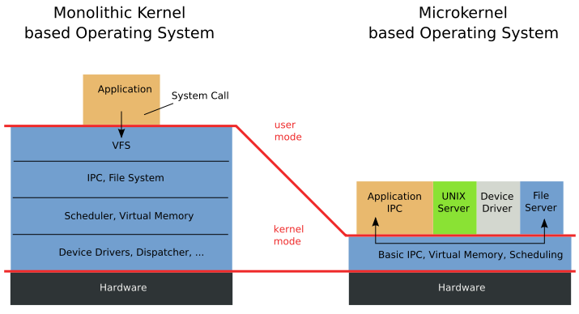
A microkernel OS
Slide adapted from http://web.cecs.pdx.edu/~walpole/class/cs533/fall2015/home.html
24

Slide 25
Modules
Many modern operating systems implement loadable kernel modules
Uses object-oriented approach
Each core component is separate
Each talks to the others over known interfaces
Each is loadable as needed within the kernel
Overall, similar to layers but with more flexible
Linux, Solaris, etc
Slide adapted from http://web.cecs.pdx.edu/~walpole/class/cs533/fall2015/home.html
25

Slide 26
Hybrid Systems
Most modern operating systems are actually not one pure model
Hybrid combines multiple approaches
Linux and Solaris : monolithic + modular
Windows : monolithic + microkernel + modular
Apple Mac OS X: Mach microkernel + BSD Unix + modular
Slide adapted from http://web.cecs.pdx.edu/~walpole/class/cs533/fall2015/home.html
26

Slide 27
Virtual Machines
Physical Machine
Application
OS
Hardware
27

Slide 28
Virtual Machines
Virtual Machine 1
Virtual Machine 2
Virtual Machine 3
Application
Application
Application
OS
OS
OS
Virtual Machine Monitor (VMM) (aka Hypervisor)
Hardware
28
Notes:
servers commonly used in their times:
1981: VAX 11/782 minicomputer
1997: a workstation
2014: a rackmount server

Slide 29
Booting of a computer System
Hardware doesn’t know where the operating system resides and how to load it.
Need a special program to do this job – Bootstrap loader.
E.g. BIOS – Basic Input Output System.
Bootstrap loader locates the kernel, loads it into main memory and starts its execution.
In some systems, a simple bootstrap loader fetches a more complex boot program from disk, which in turn loads the kernel.
29
Notes:
http://www.gsmarena.com/samsung_galaxy_note_3-5665.php

Slide 30
Booting of a computer System
Reset event on CPU (power up, reboot) causes instruction register to be loaded with a predefined memory location. It contains a jump instruction that transfers execution to the location of Bootstrap program.
This program is form of ROM, since RAM is in unknown state at system startup. ROM is convenient as it needs no initialization and can’t be affected by virus.
30
Notes:
http://www.gsmarena.com/samsung_galaxy_note_3-5665.php

Slide 31
Shell
Outermost layer of the opearting system
Shells incorporate a programming language to control processes and files, as well as to start and control other programs.
Login: The system locates the name of the shell program to execute
After it is executed, the shell displays the command prompt
Interface to the OS
Interactive
Shell scripts- A shell script is a sequence of shell and operating system commands that is stored in a file
31
Notes:
http://www.gsmarena.com/samsung_galaxy_note_3-5665.php

